Slide 1
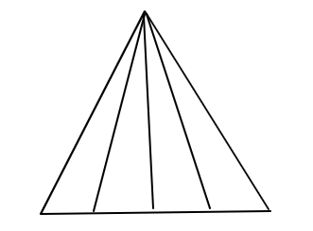
1. How many triangle is in the given figure?
(A) 10
(B) 12
(C) 14
(D) 16

Slide 2
1. How many triangle is in the given figure?
(A) 10
(B) 12
(C) 14
(D) 16

Slide 3
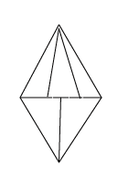
2.How many triangles are there in this given figure
8
b) 9
c) 10
d) 12

Slide 4
2.How many triangles are there in this given figure
8
b) 9
c) 10
d) 12

Slide 5
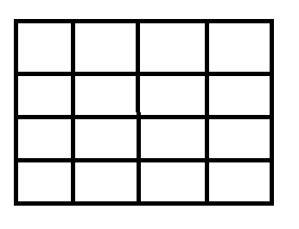
3.How many squares in the figure?
(A) 16
(B) 17
(C) 26
(D) 30

Slide 6
3.How many squares in the figure?
(A) 16
(B) 17
(C) 26
(D) 30

Slide 7
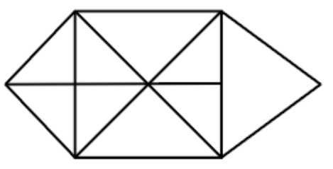
4. How many triangles are present in the following figure ?
A 18
B 20
C 14
D 16

Slide 8
4. How many triangles are present in the following figure ?
A 18
B 20
C 14
D 16

Slide 9
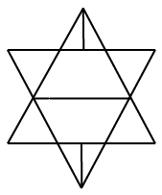
5. How many triangles are there in this figure?
10
b) 12
c) 14
d) 16

Slide 10
5. How many triangles are there in this figure?
10
b) 12
c) 14
d) 16

Slide 11
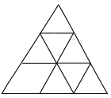
6. How many triangles are there in this figure?
10
b)11
c) 10
d) 15

Slide 12
6. How many triangles are there in this figure?
10
b)11
c) 10
d) 15

Slide 13
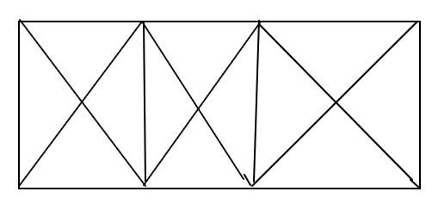
7.Find the number of triangles?
(A) 29
(B) 25
(C) 28
(D) 24

Slide 14
7.Find the number of triangles?
(A) 29
(B) 25
(C) 28
(D) 24

Slide 15
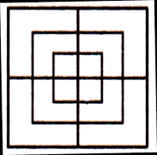
8.In the following questions, count the number of squares in the given figures.
(a) 8
(b) 12
(c) 15
(d) 18

Slide 16
8.In the following questions, count the number of squares in the given figures.
(a) 8
(b) 12
(c) 15
(d) 18

Slide 17
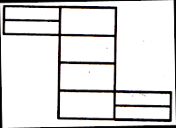
9.In each of the following questions, count the number of rectangles in the given figure.
(a) 8
(b) 17
(c) 18
(d) 20

Slide 18
9.In each of the following questions, count the number of rectangles in the given figure.
(a) 8
(b) 17
(c) 18
(d) 20

Slide 19
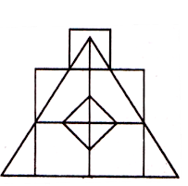
10.Find the number of triangles and squares in the given figure
(a) 21 triangles, 7 squares
(b) 18 triangles, 8 squares
(c) 20 triangles, 8 squares
(d) 22 triangles, 7 squares

Slide 20
10.Find the number of triangles and squares in the given figure
(a) 21 triangles, 7 squares
(b) 18 triangles, 8 squares
(c) 20 triangles, 8 squares
(d) 22 triangles, 7 squares

Slide 21
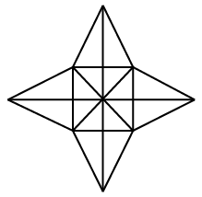
11.How many triangles are there in the given figure ?
28
b) 36
c) 40
d) 48

Slide 22
11.How many triangles are there in the given figure ?
28
b) 36
c) 40
d) 48

Slide 23
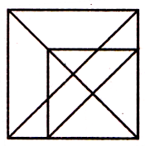
12.Find the number of triangles in the given figure.
(a) 16
(b) 18
(c) 20
(d) 21

Slide 24
12.Find the number of triangles in the given figure.
(a) 16
(b) 18
(c) 20
(d) 21

Slide 25
13.Find the number of triangles and squares in the given figure.
(a) 21 triangles, 7 squares
(b) 18 triangles, 8 squares
(c) 20 triangles, 8 squares
(d) 22 triangles, 7 squares

Slide 26
13.Find the number of triangles and squares in the given figure.
(a) 21 triangles, 7 squares
(b) 18 triangles, 8 squares
(c) 20 triangles, 8 squares
(d) 22 triangles, 7 squares

Slide 27


